Slide 1

Impact of GDPR in Project Planning
Project Management Symposium
Neelov Kar and Subhro Mitra

Slide 2
Agenda
Learning Objectives
Overview of GDPR
Inherent Project Data
Global Application Development Project
Scope management plan – DPIA
Stakeholder management plan
Communication management plan
Human resource management plan
Risk management plan
"Data Privacy" and "Information Security Management"
Case Study

Slide 3
Learning Objectives
Understand the history of personal data protection in Europe
Gain a comprehensive understanding of the concepts and approaches required for the effective alignment with the General Data Protection Regulation
Gain the knowledge and skills required to advise organizations how to manage personal data
Acquire the expertise for analysis and decision making in the context of personal data protection

Slide 4
Overview of GDPR
General Data Protection Regulation
  Minimize security incidents
  Build customer trust
  Retain existing customers and attract new customers
  Facilitate data access
  Ensure a stronger enforcement of rules
  Enable accurate storage of customer data

Slide 5
Inherent Project Data
Project Team Members Data
Data of Customer Personnel
Data of Vendor Personnel
Personal Data of Other Stakeholders
Other Research Data Containing PII

Slide 6
Global Application Development Project
Data protection by design and by default (Article 25)
Data Minimization
Data Storage Limitation
Data Subject’s Right to Correct Data (Article 15 – 18, 20 & 21)

Slide 7
WBS
Project
Project Management
Information Security
Other Deliverables
GDPR Assessment
DPIA
NW Analysis

Slide 8
Scope management plan – DPIA
Perform GDPR Assessment
Article 35 – Data Protection Impact Assessment
Perform Data Exchange requirements for the project – May require Binding Corporate Rules (BCR) ( Article 47)
Provision for Subject Access Request (SAR) (Recital 63)

Slide 9
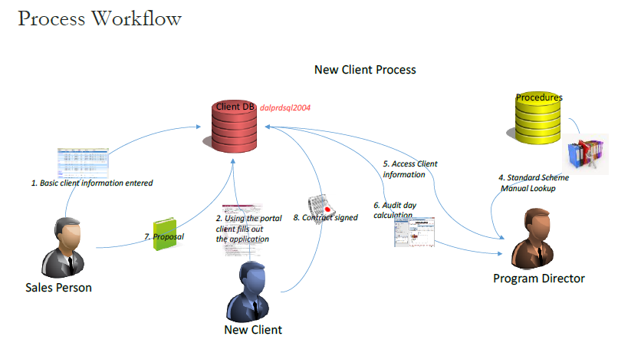

Slide 10
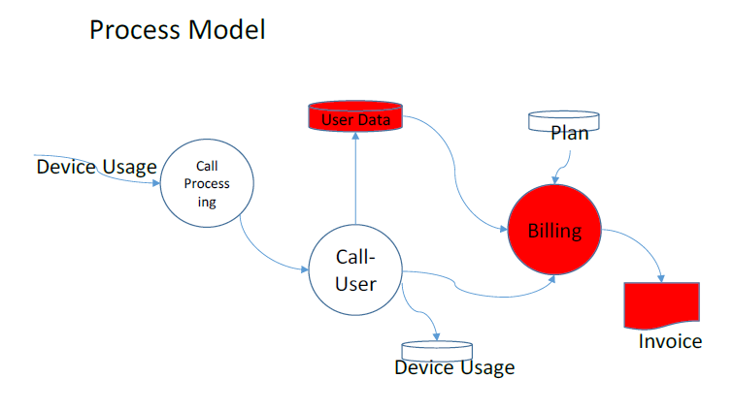

Slide 11
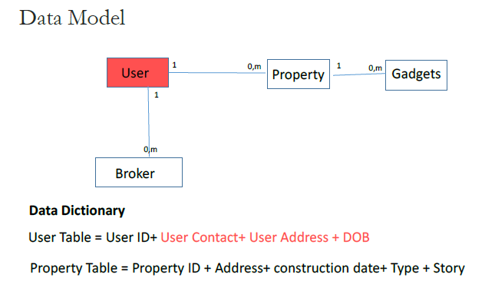

Slide 12
Stakeholder management plan
Supervisory Authority as one of the Stakeholders (Section 6, Article 33 & 51)
Data Protection Officer (Article 37)
Data Processor/ Data Controller (Article 28/24)
Representation in EU (Article 27)

Slide 13
Communication management plan - Data Beach
Incident Management
Communication of a personal data breach to the data subject (Article 34)
Notification of a personal data breach to the supervisory authority (Article 33)

Slide 14
Risk Management
Failure to Perform GDPR Assessment
Data Subject Lodging a Complaint
Data Breach Taking Place
Failing to Meet Subject Access Request

Slide 15
"Data Privacy" and "Information Security Management"
Having a Good Information Security Management System in Place
Having Competent People with GDPR Knowledge
Protecting Data at Rest and in Transit

Slide 16
Information Security Standards
ISO 27001:2013
ISO 27018
PCI
NIST
SSAE16
CSA STAR
FISMA
FedRAMP

Slide 17
Case Study

Slide 18
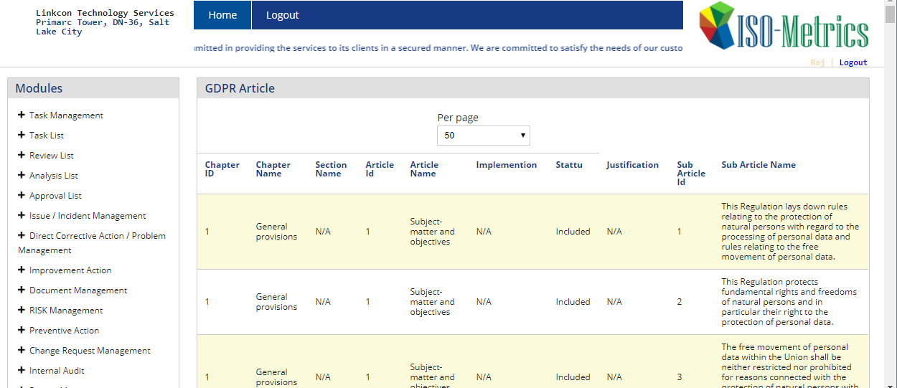
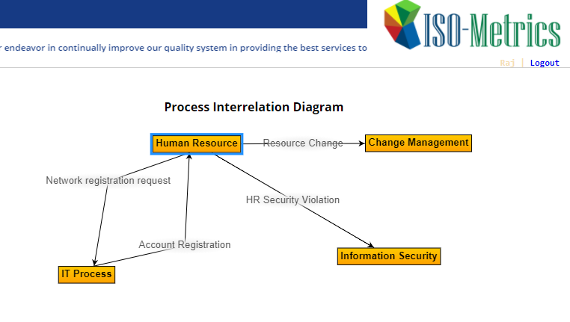
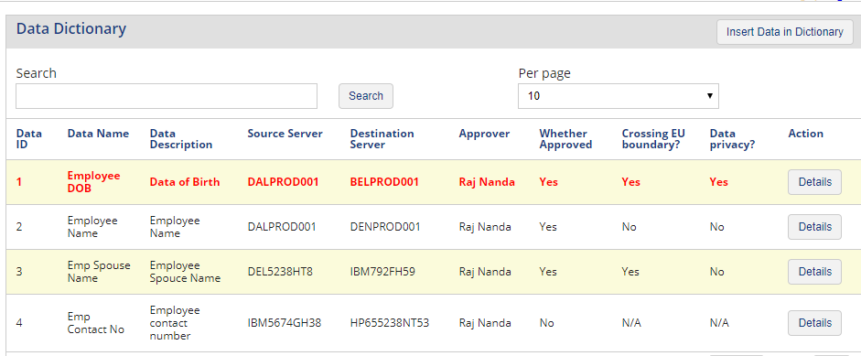
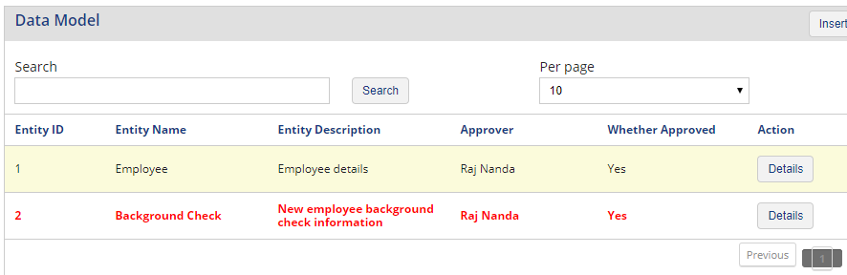

Slide 19
Contact Information
Neelov Kar
neelov@pmgame.net
469-258-8565
Subhro Mitra
Subhro.Mitra@untdallas.edu
701-200-4699

