Slide 1



Typical issues when implementing and ISO 27001 management system, and how to avoid them
Neelov Kar, BSI Group
Willy Fabritius, BSI Group
Copyright © 2016 BSI. All rights reserved.

Slide 2

Agenda
Analysis of Issues from Past Audit Data
Issues in Implementation of ISO 27001
General Security Threat
Some Challenges
Q & A

Slide 3
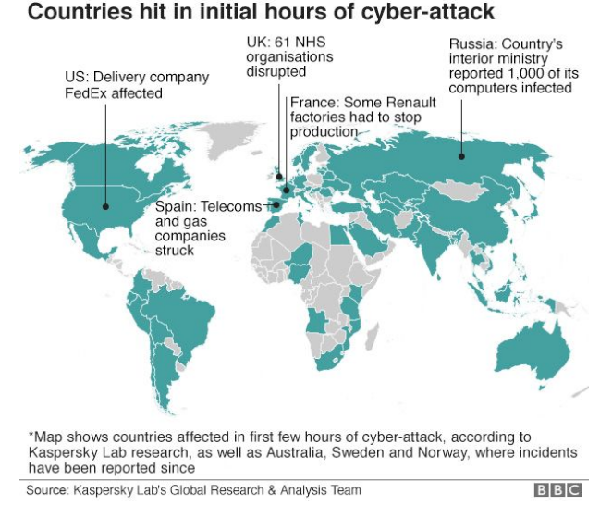
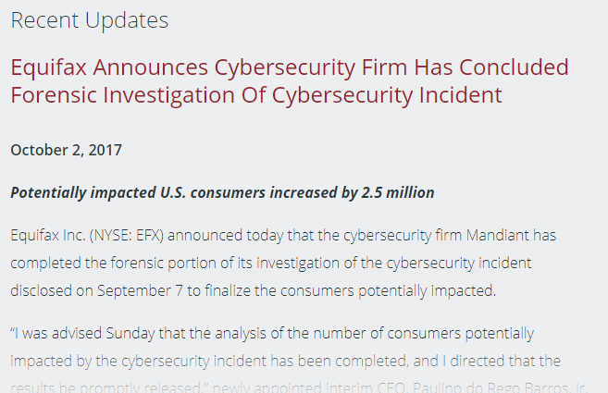
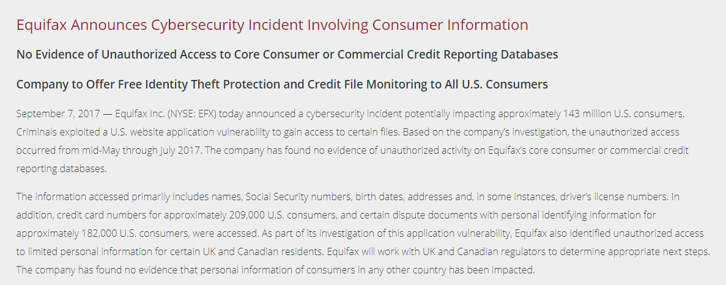
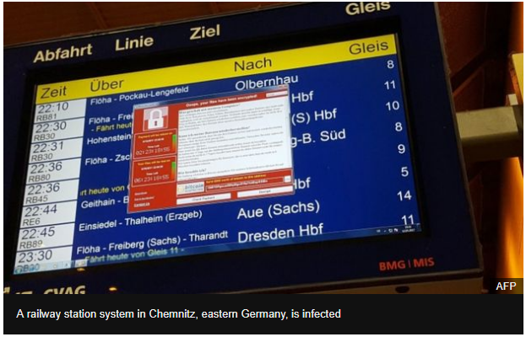
Information Security Risks in Today’s
World

Slide 4
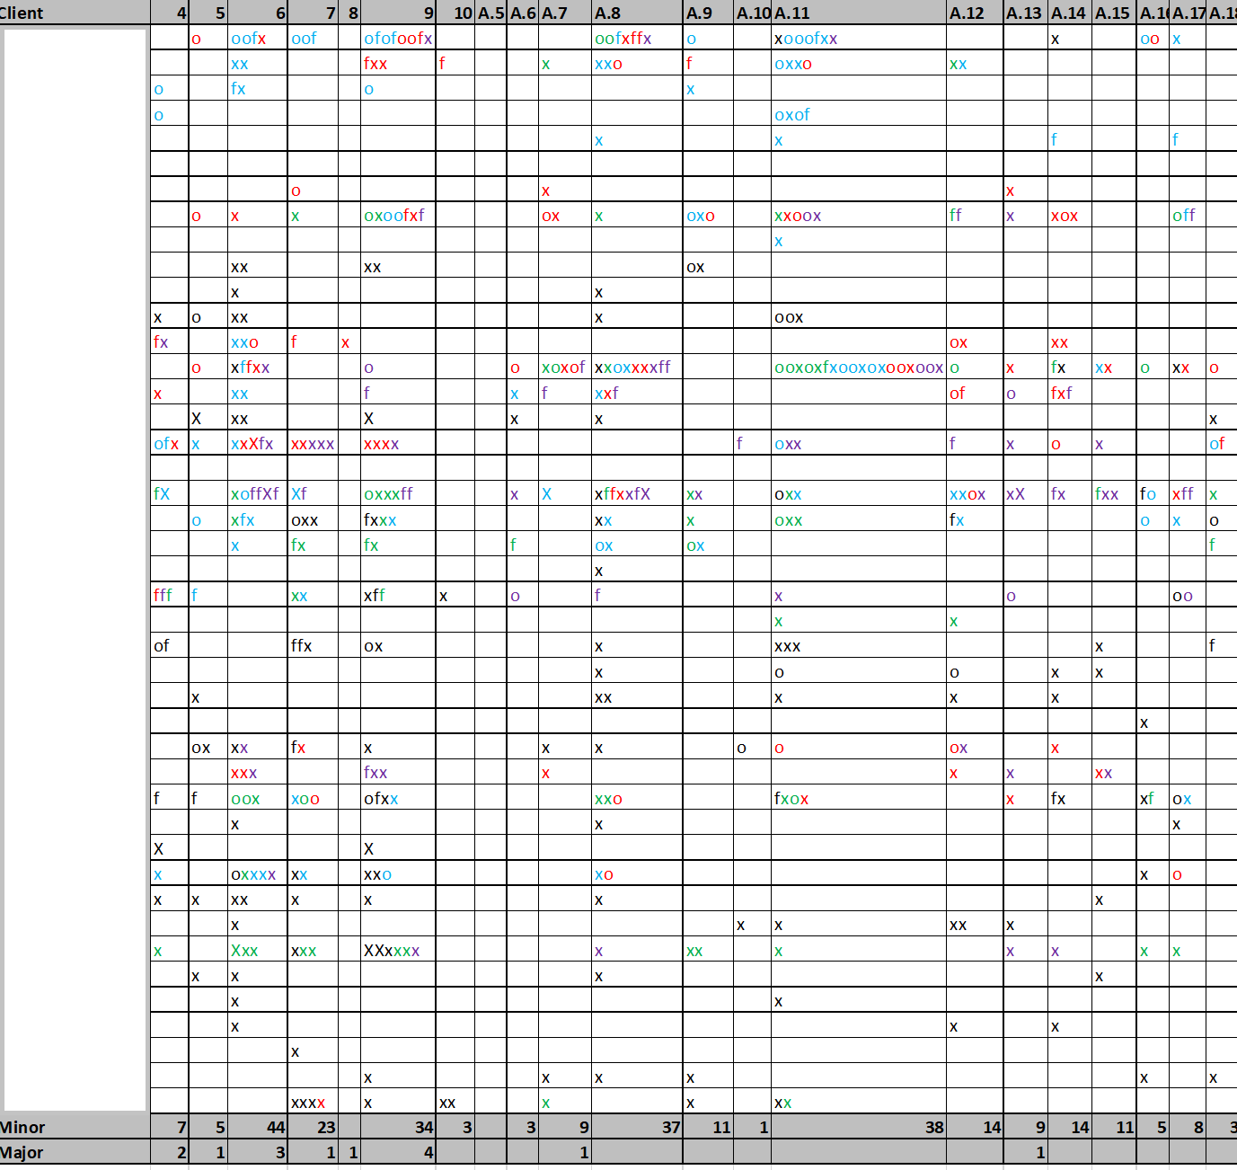
Audit Findings from 2013 till Date
A sample of about 50 Clients’ audit data for last 5 years has been analyzed
Legends:
X- Major
X – Minor
O- Observation
F - OFI
Color code:
Black – 2013
Green – 2014
Blue – 2015
Red – 2016
Purple - 2017
Copyright © 2017 BSI. All rights reserved.
27K Summit
4

Slide 5
Distribution of Findings
Planning
Performance
Asset Management
Physical & Environmental Security

Slide 6
Distribution of Findings

Slide 7
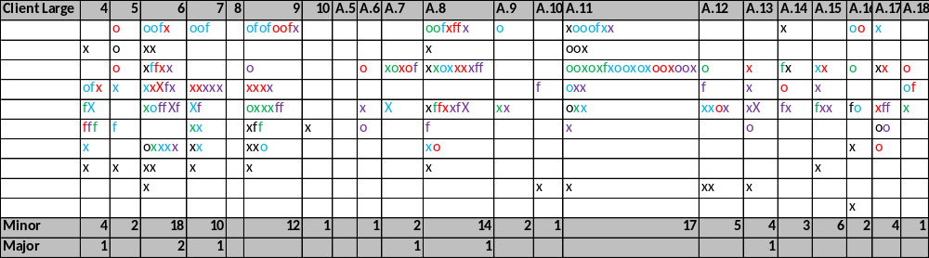
Findings for Large Clients

Slide 8
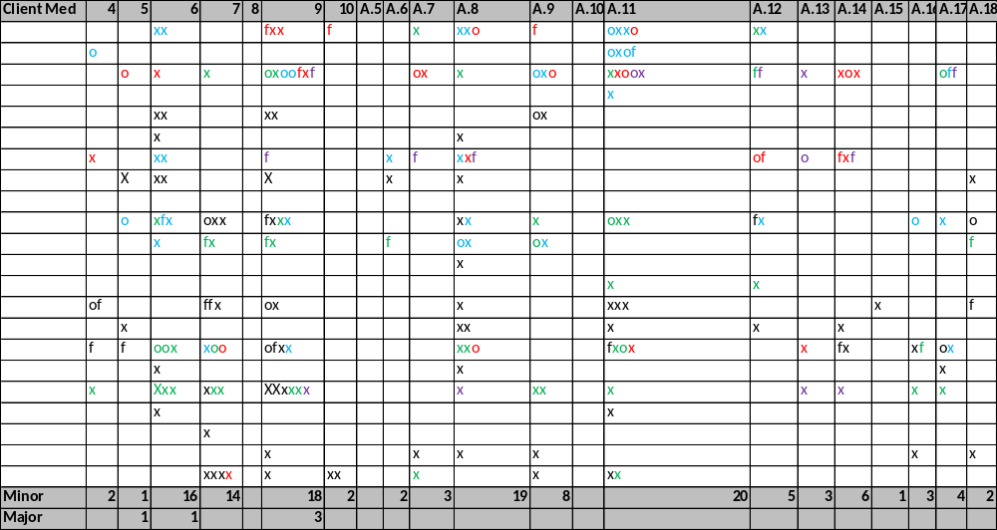
Findings for Medium Clients

Slide 9
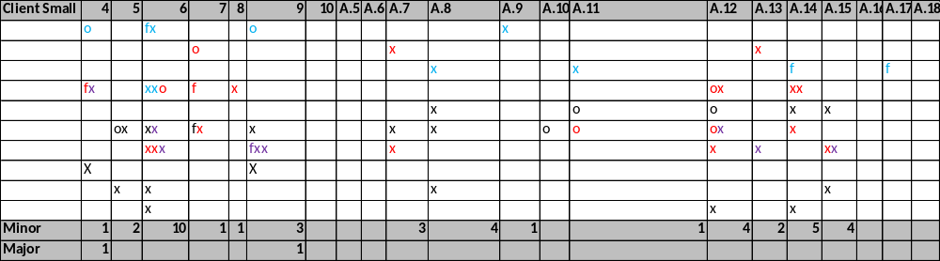
Findings for Small Clients

Slide 10
Pattern
Large and Medium Clients have pretty similar patterns
Pattern for Small Clients is little different

Slide 11
Patterns more…..
Watch how similar are the patterns for Large and Medium Clients

Slide 12
Patterns more…..

Slide 13
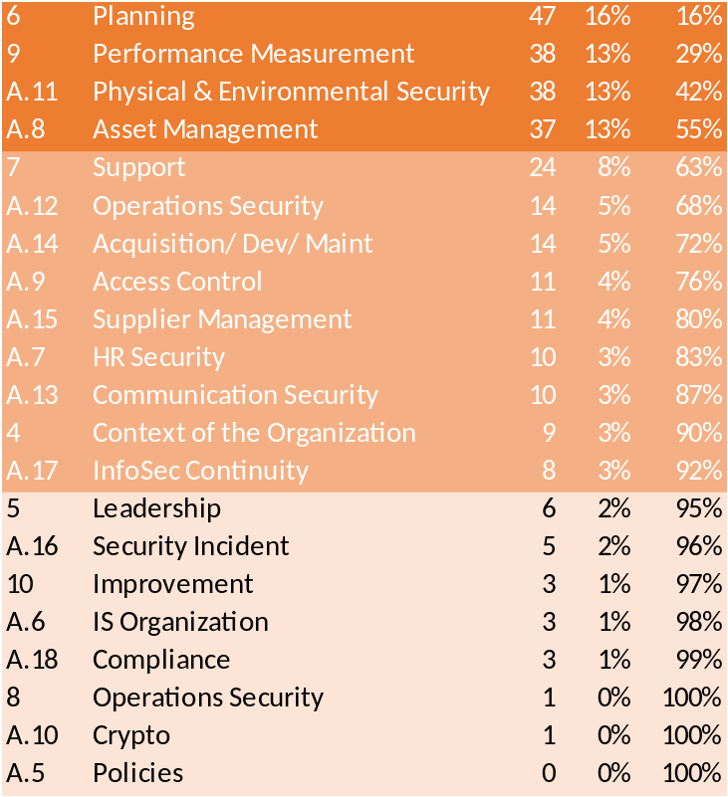
Pareto
Main Issues that constitute 80%
- Planning
- Performance Management
- Physical & Environmental Security
- Asset Management
- Support
- Operations Security
- Acquisition/ Development/ Maintenance
- Access Control
- Supplier Management

Slide 14
Most Common Findings for Planning
Not all SOA controls are assigned to risks
Residual Risk is not calculated
Acceptance of Risk is missing
Risk review record not found
Risks are not prioritized
Preventive actions for the risk are not documented
Opportunities are not assessed
Risk Management Methodology is not available
Gross Risk Calculation is not correct
Heat Map and the Risk Level do not match
Annex A control/ SOA control is not assigned to Risks

Slide 15
Most Common Findings for Performance
Management Review
  Management review does not address all the requirements of 9.3 a-f
Internal Audit
  Audit program is missing
  Not all the controls audited
  Main clause not audited
  Auditors are not qualified

Slide 16
Most Common Findings for HR Security
Background check
  New Hire getting access before completion of background check
Security Awareness Training not completed
Policies not signed
Assets not retrieved after termination
NW Access not revoked after termination

Slide 17
Most Common Findings for Physical & Environmental Security
Cardboard Boxes
Papers on Desk
Unattended hard drive
Tailgating
Camera out of synch

Slide 18
Most Common Findings for Asset Management
Asset Inventory
Disposal of Media
Removable Media
Media Transfer
Information Labeling

Slide 19
Some Challenges

Slide 20
Top Management
Involvement
Direction
Resourcing
Lack of understanding the importance

Slide 21
Selecting the Right Tools
Risk Management Tool
Document Management Tool
Asset Management Tool
System Monitoring Tool
Scanning

Slide 22
Selecting the Right Technology
DLP
White Listing
Scanning for OWASP Top Ten
Remote Desk Top
MDM
2 FA
DoD 7

Slide 23
Selecting the Right Resources
ISO Coordinator
Consultant
NW Engineer
Facility Manager
Auditors trained in ISO 27001
Business Continuity Experts
Risk Management Experts

Slide 24
Thank You
Q & A
Neelov Kar
Neelov.kar@bsigroup.com
469-258-8565
Willy Fabritius
Willibert.Fabritius@bsigroup.com
571-423-9810

