Slide 1



Risk Management vis-a-vis Annex A Control of New ISO/IEC 27001
Neelov Kar, BSI Group
Copyright © 2016 BSI. All rights reserved.

Slide 2
Agenda
Information Security Risks in Today’s World
Most Common Findings
Organization and Risk
Building an ISMS Organization
Risk & Annex A Views
A Tutorial
Conclusion
Question & Answer

Slide 3
Information Security Risks in Today’s
World
Cyber War between Estonia and Russia
DNC’s Email Server Hacked by Russia
Delta’s Datacenter Crashed – 100’s of Flight cancelled on 08/08/16
IRS, Target, Neiman Marcus, Home Depot , AshleyMadison sites hacked
Sony’s site was attacked by state sponsored hackers of North Korea
LinkedIn account Data Breach 05/25/2016
Secret Sauce Case
Heartbleed/ Poodle/ Shell Shock
Ransomware
Disgruntled employee
Countdown to Zero Day: Stuxnet and the Launch of the World’s First Digital Weapon
My Uber account compromised

Slide 4
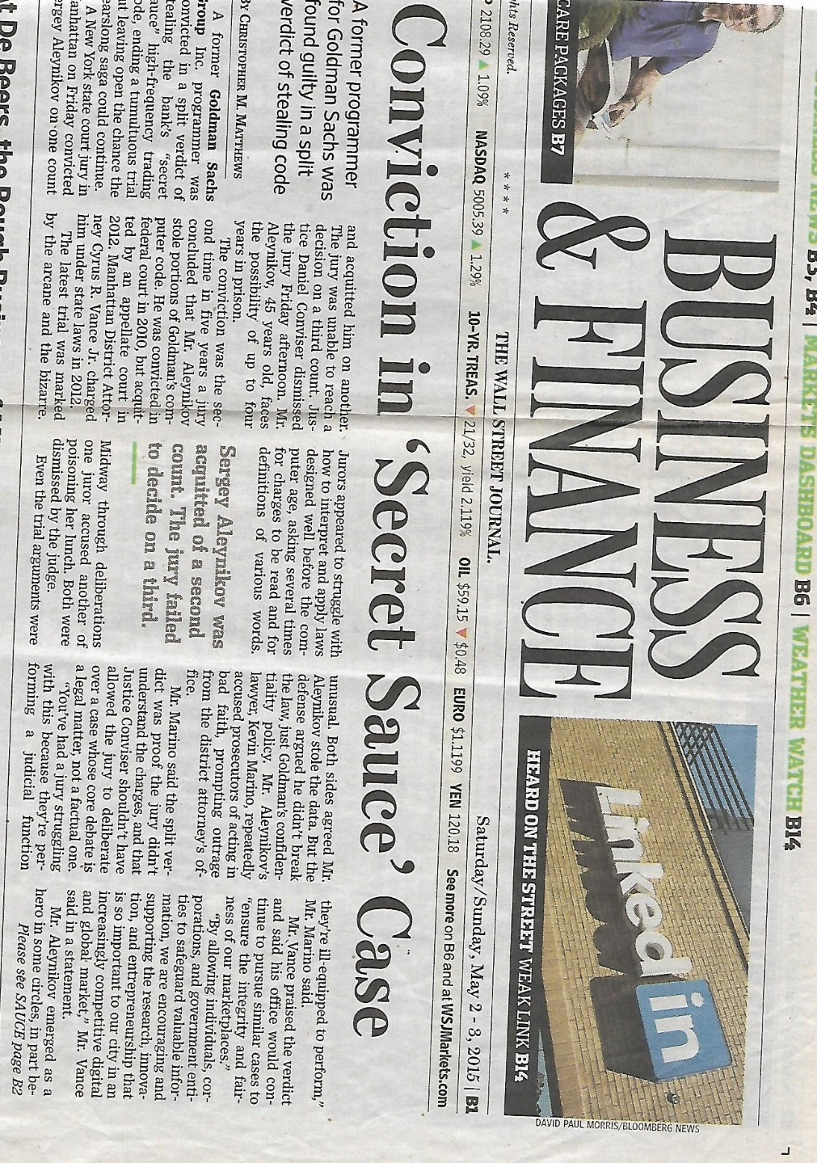
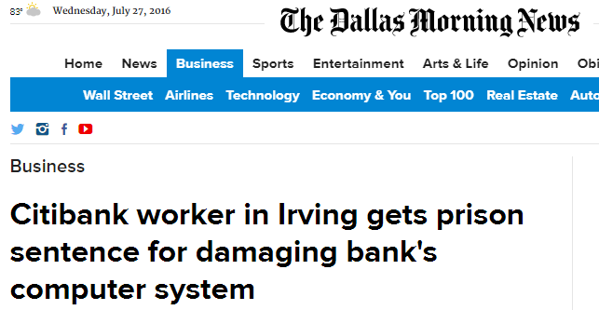
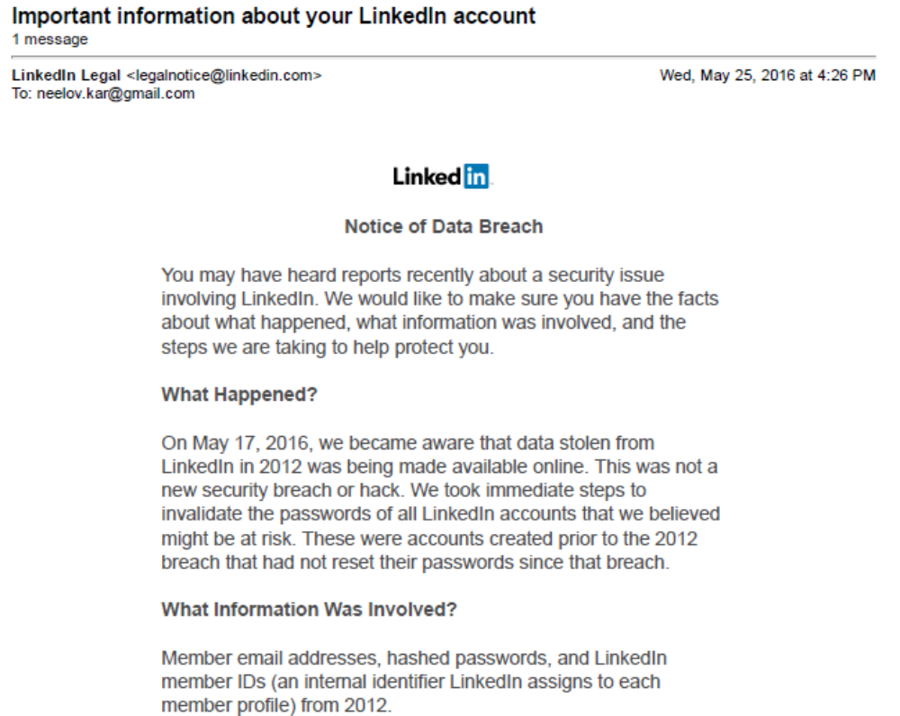
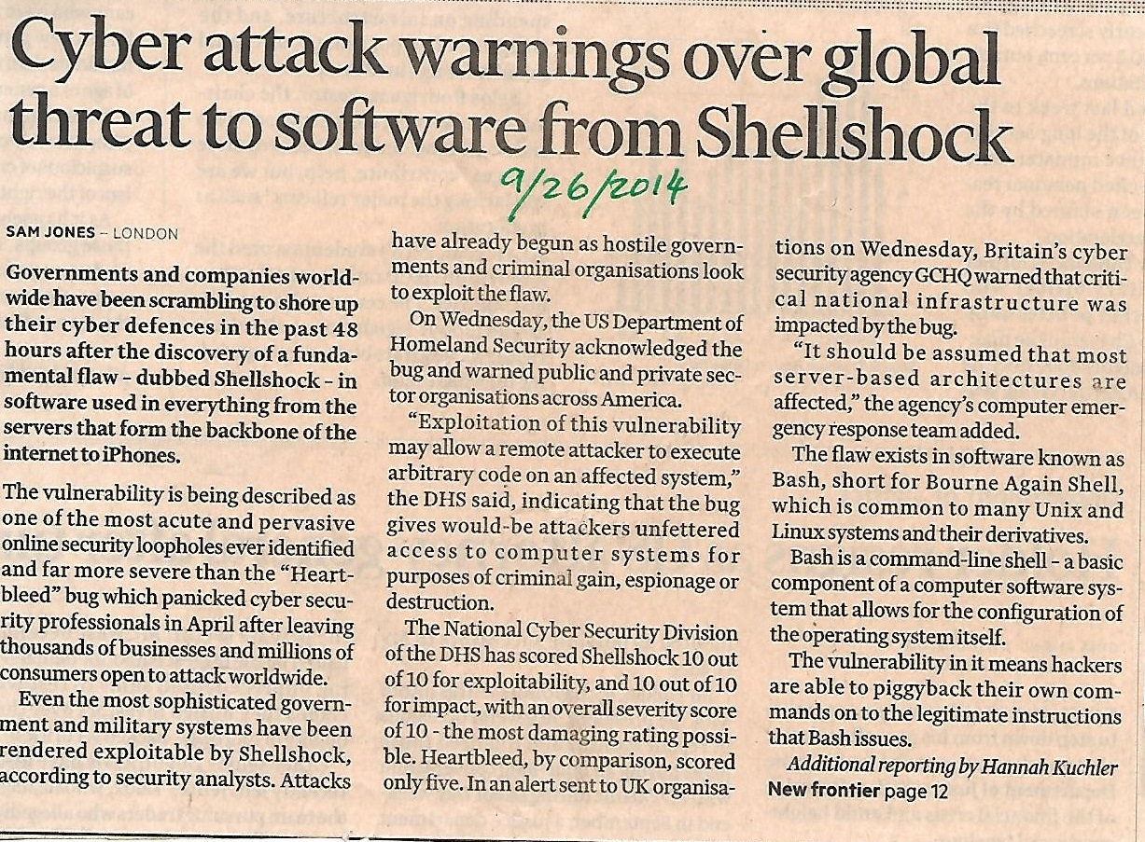

Slide 5
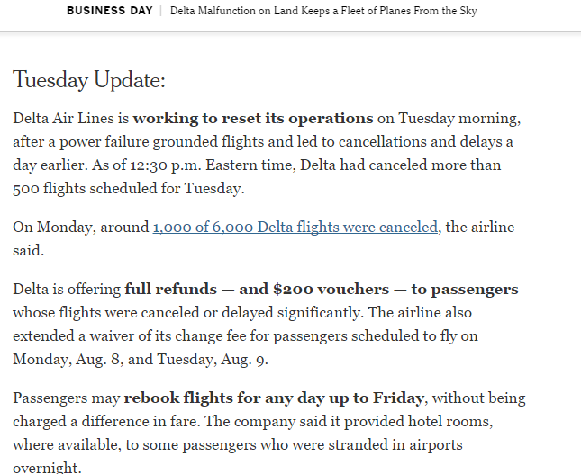
Cost of Risk
2000 X 200 X 100 =$40,000,000
McAfee estimates the global cost to companies and consumers at between $375B and $500B annually

Slide 6
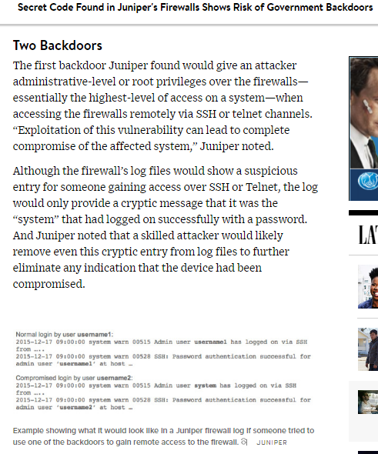

Slide 7
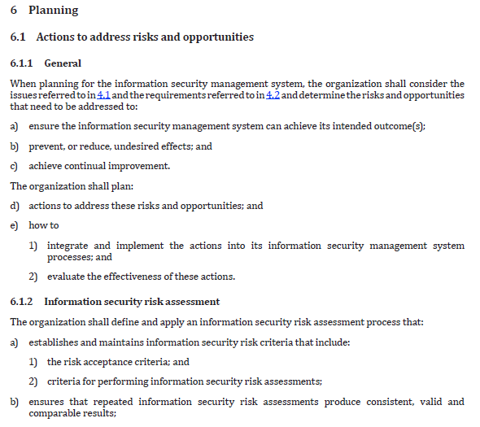
ISO 27K - Planning

Slide 8
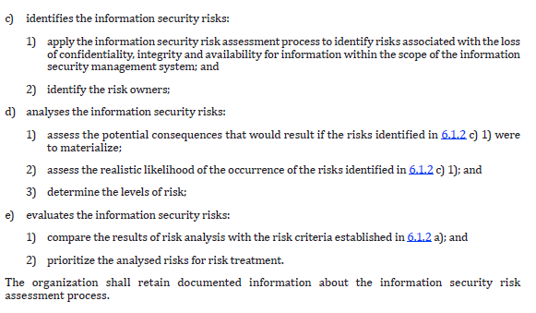
ISO 27K - Planning

Slide 9
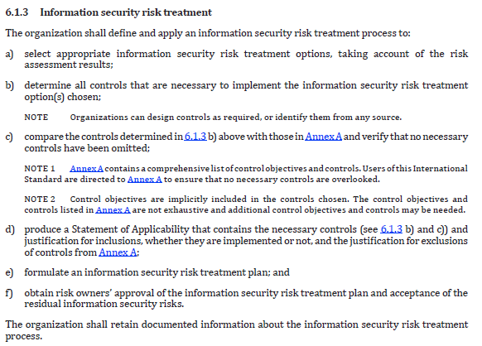
ISO 27K - Planning

Slide 10
Most Common Findings
Not all SOA controls are assigned to risks
Residual Risk is not calculated
Acceptance of Risk is missing
Risk review record not found
Risks are not prioritized
Preventive actions for the risk are not documented
Opportunities are not assessed
Risk Management Methodology is not available
Gross Risk Calculation is not correct
Heat Map and the Risk Level do not match
Annex A control/ SOA control is not assigned to Risks

Slide 11
Organization and Risk
Risk of the organization depends on type of business
Depends on organization’s Risk Appetite and Risk Tolerance
Size of the business
Depends on what kind of data/ information is handled by the business
Depends on the maturity of the organization: People, Process & Tools
Capability of detection of security issues/ risks
Capability of recovering from a security issue
Contact with Special Interest Groups
Proactive risk assessment
Implementation level of controls

Slide 12
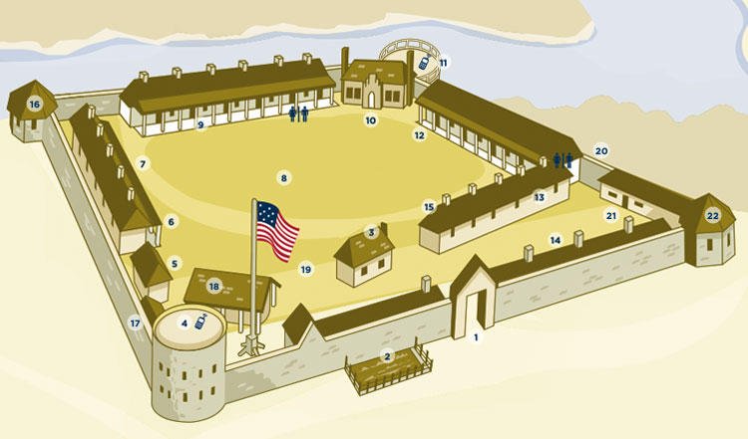

Slide 13
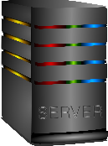

Slide 14
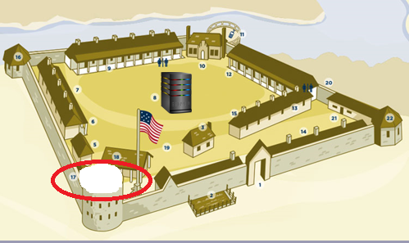
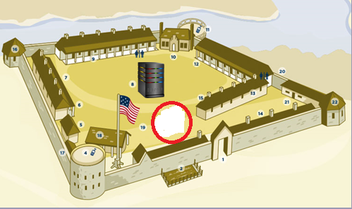
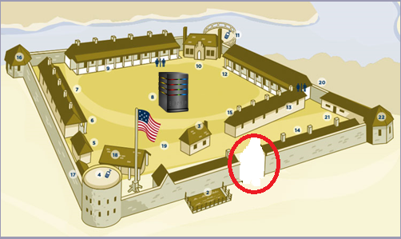
Check post is missing
Watch tower is missing
Main gate is missing
If you miss a control there will be a risk

Slide 15
Building an ISMS Organization
Two Perspectives of the organization
  Information Security Risks as applicable for an organization
  Applicability of Annex A controls

Slide 16
Risk and Control have a many to many relationship
One Risk can be mitigated by one or more controls
For example:
Disgruntled employee Access control A.9
Security Policy A.5
HR Security A.7
One Control can be a mitigating factor for multiple Risks
For example:
Cryptography A.10 Stolen Laptop
Unauthorized copying of customer data
Hacking of information while transmitting over internet

Slide 17
Risk View of the Organization
Control A
Risk 1
Control B
Mitigating Controls
Control C
Control A
Control B
Control C
Risk 2
Control D
Control D
Control E
Control E
Control F
Control C
Control G
Risk 3
Control E
Control F
Control G

Slide 18
Annex A View of the Organization
Annex A Controls
Applicable Controls
Include/ Exclude
Control A
Control A
Control B
Control B
Control C
Control C
Control D
Control E
Control E
Control F
Control F
Control G
Control G
Control I
Control H
For example A.14.2.7 – Outsourced Development
Control N

Slide 19
Statement of Applicability
List of Included
Controls from
Annex A
Other Controls
from Other Standards
Like: NIST, PCI, 27018
+

Slide 20
Annex A View of the Organization
Annex A Controls
Applicable Controls
Include/ Exclude
Control A
Control A
Control B
Control B
Control C
Control C
Control D
Control E
Control E
Control F
Control F
Control G
Control G
Control I
Control H
Control Z
Control N

Slide 21
Compare
Mitigating Controls
Applicable Controls
Control A
Control A
Control B
Control B
Control C
Control C
Control D
Control E
Control E
Control F
Control F
Control G
Control G
Control I
Control Z

Slide 22
A Tutorial

Slide 23
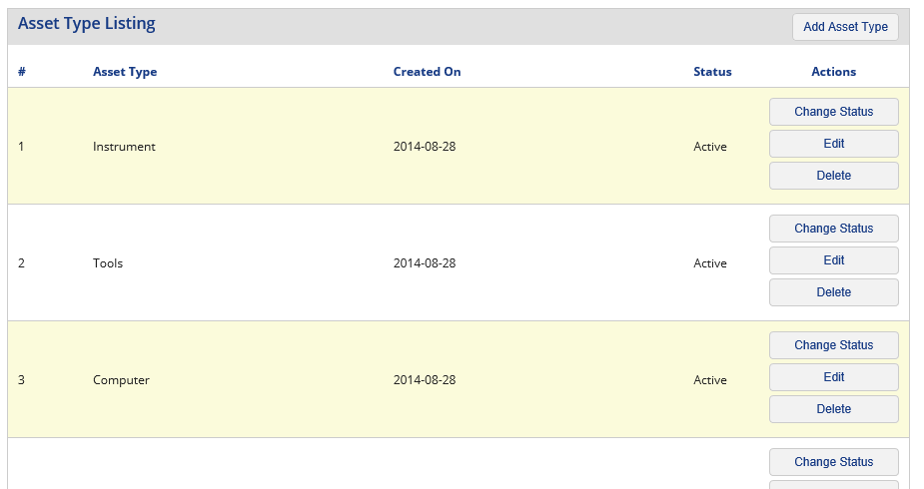
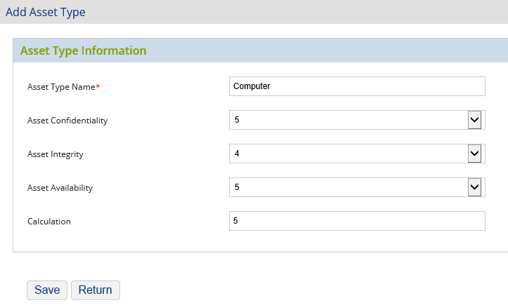
Asset Management
Risk Impact Value
It allows you to define
- Confidentiality
- Integrity
- & Availability
for each Asset Type which allows to calculate the Risk Impact

Slide 24
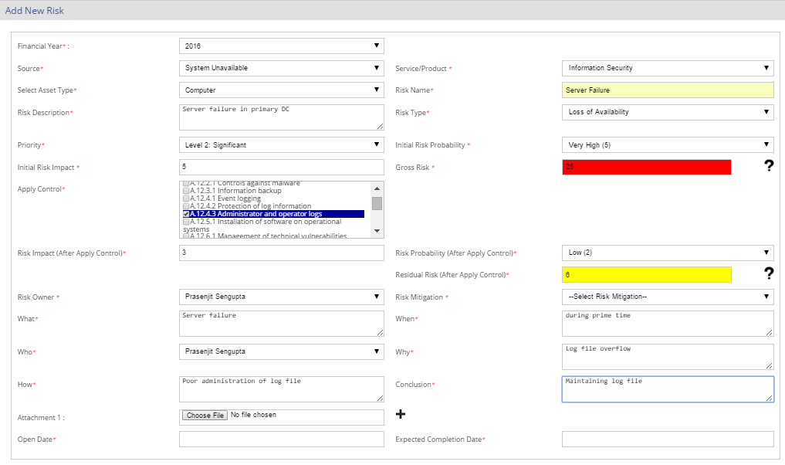
Risk Identification
Risk Impact transferred
from Asset type master
Assign Priority
Risk likelihood
Assign controls included in SOA
Gross Risk
Residual Risk
Risk Owner
Initial analysis
through 4W & 1 H
Select
Mitigation approach

Slide 25
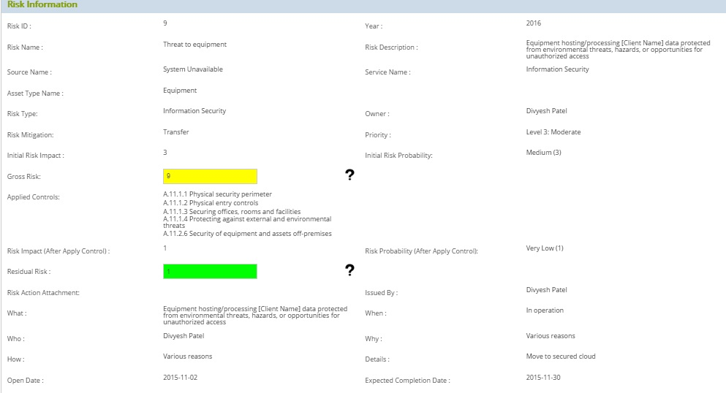
Sample Risk

Slide 26
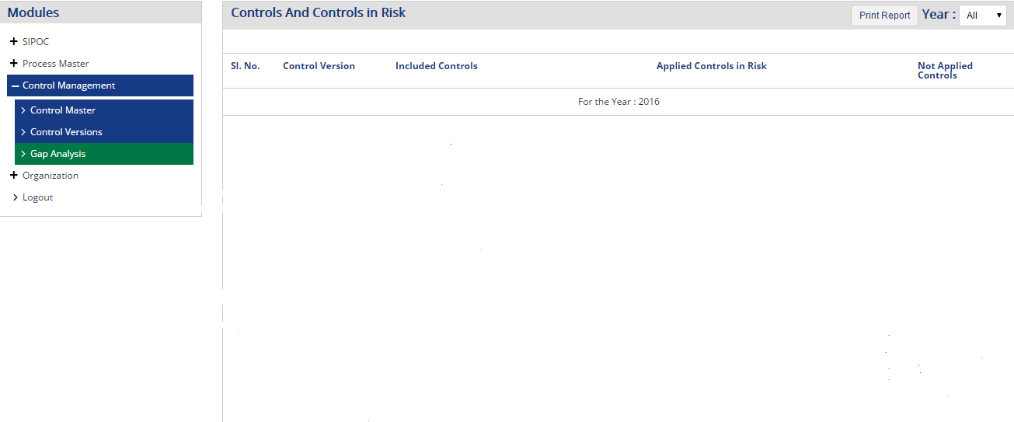
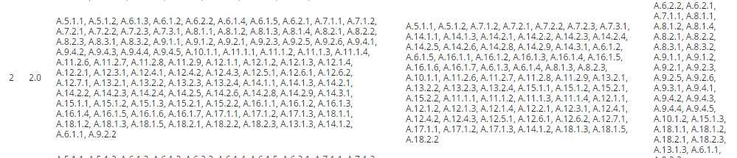
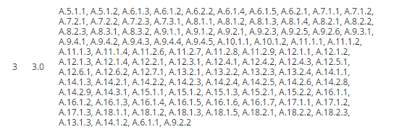
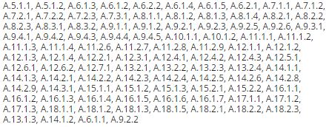
No gaps

Slide 27
Conclusion
Annex A Controls and Risk are complementary to each other
It allows you to identify and manage the risk
Risk Management is a continuous process
Use ISO 31000 and ISO 27005 as additional guidelines

Slide 28
Thank You
Q & A
Neelov Kar
Neelov.kar@bsigroup.com
469-258-8565

Slide 29
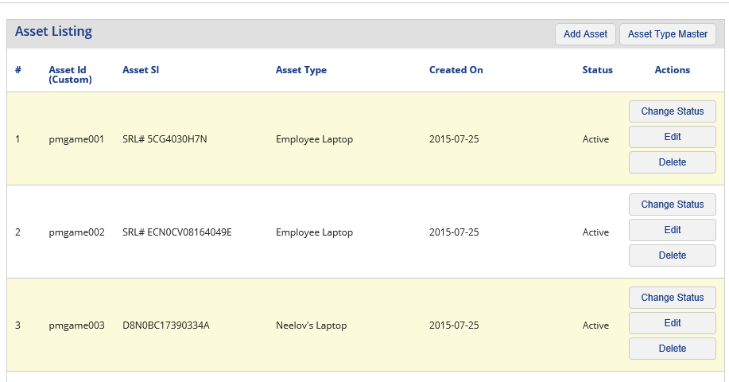
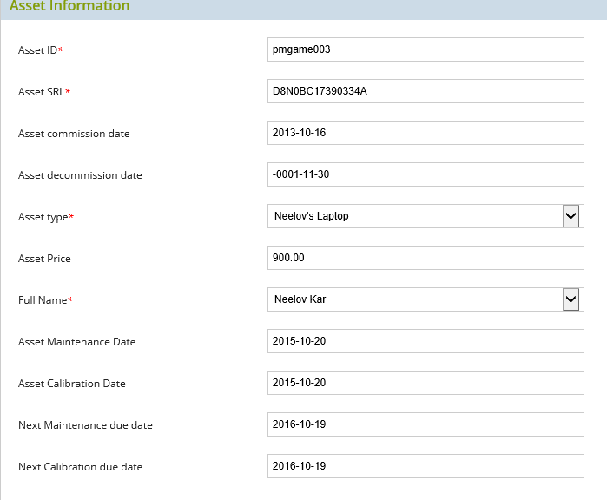
Asset Master
Asset Master allows you to keep details of assets like servers and Computers. It is also possible to store the details of Generators and track their maintenance

Slide 30
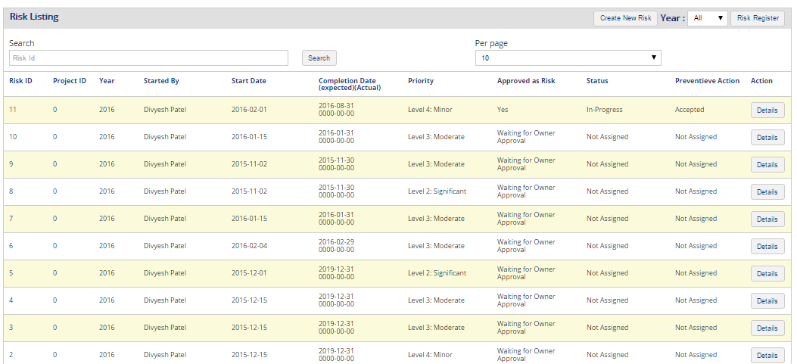
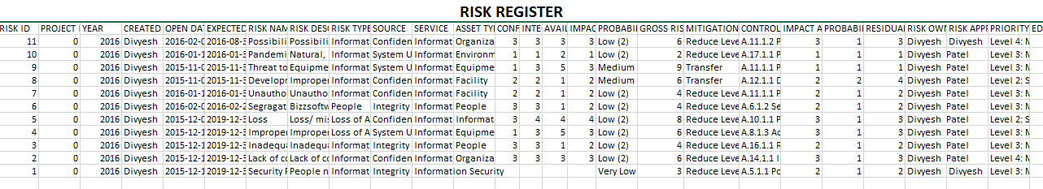
Risk Register
You can print the Risk Register in Excel

Slide 31
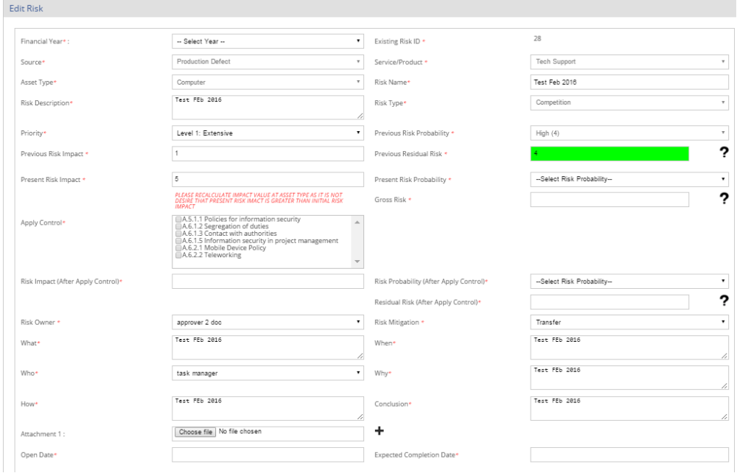
Edit/ Review Risk
Data from previous risk assessment is imported to review the new situation. It allows you to edit the data to come up with the new risk register for the new period

Slide 32
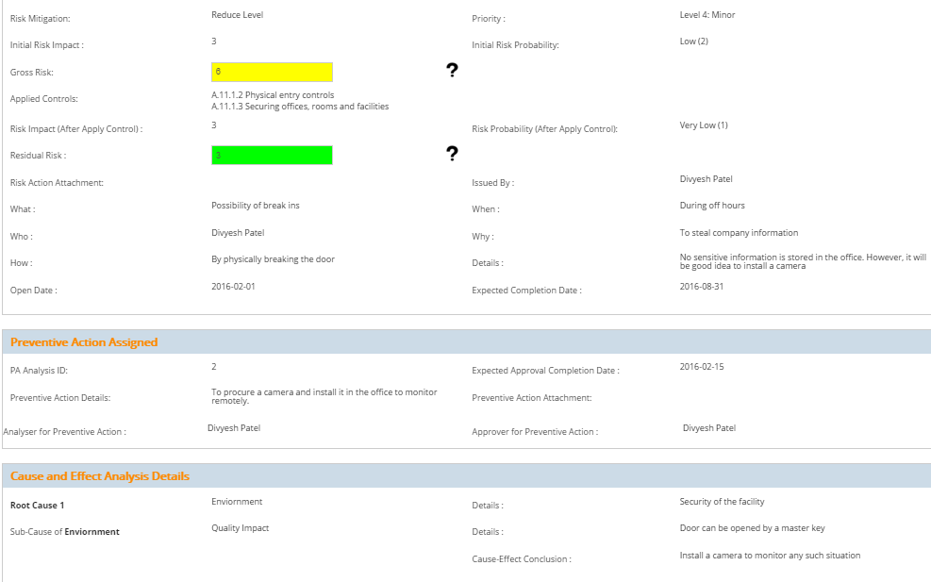
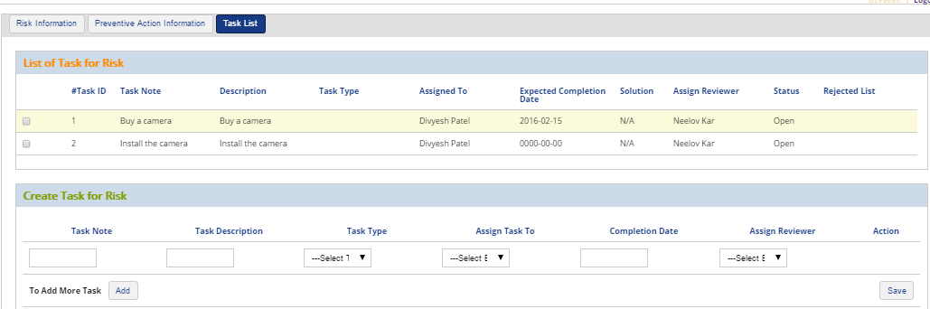
Managing Preventive Action from Risk
Preventive Action
Root Cause Analysis
Preventive Action Task Tracking

